Slide 1

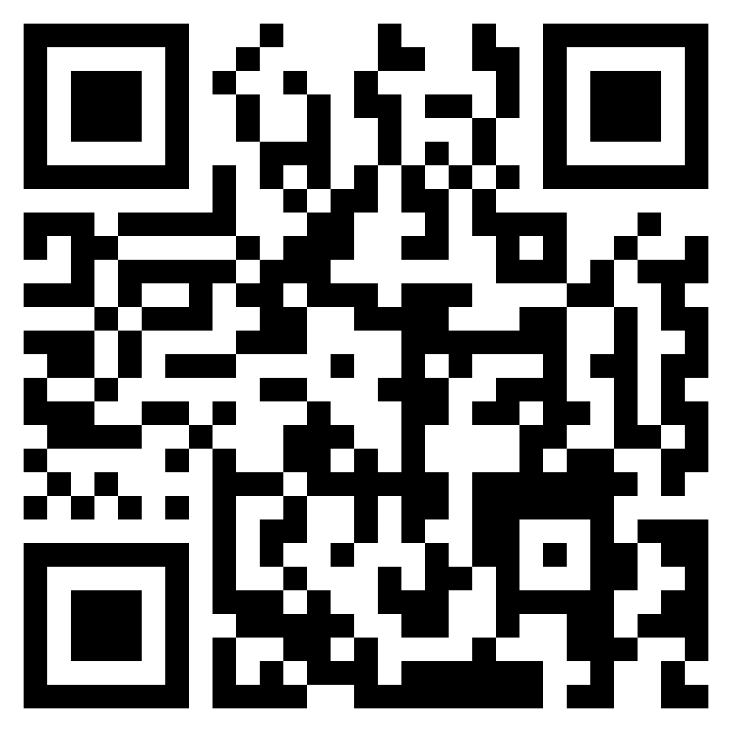



Welcome to the {iddoverse}: An R package for Converting IDDO-SDTM Data to Analysis Datasets
Rhys Peploe^{1,2}, Kasia Stepniewska^{1,2}, James Watson^{1,2,3} and Prabin Dahal^{1,2}
¹ Infectious Disease Data Observatory, University of Oxford, UK; ² Centre for Tropical Medicine and Global Health, Nuffield Department of Medicine, University of Oxford, Oxford, UK; ³ Oxford University Clinical Research Unit, Ho Chi Minh City, Viet Nam
Background
Objectives
Process for PREP functions
Study Data Tabulation Model (SDTM) provides a coherent frameworks for the storage and pooling of studies and clinical trials.
Using SDTM for heterogeneous historical studies requires customisation in the standard implementation at the Infectious Disease Data Observatory (IDDO).
However, the SDTM format is not as accessible for researchers in Low- and Middle-Income Countries (LMICs) due to education, time and resource limitations.
Creation of an open-source package to assist in the conversion of SDTM data to analysis datasets, using IDDO implementation.
This reduces the amount of duplicated work and prompts reproducible outputs.
The effectiveness of packages like {admiral} (part of the Pharmaverse) are limited since our implementation is not compatible, and our audience are not regular SDTM users.
Provide additional features to improve data use, such as recalculating Body Mass Index results and including Child Growth Standards into outputs
PREP_DM, PREP_LB_BL, PREP_VS_FU are examples of functions in the package.
For each domain, they convert blanks to NA and results to upper case and character class
Amalgamate data using standardised results or decoded terms, and where NAs exist fill with modified or original results
Filter to variables of interest, which users can specify and add to using the VARS parameter, other filters may also be applied (domain dependent)
Pivot the domain wider so the terms or tests are now columns
Package
Take a Laboratory (LB) domain, curated into our implementation of SDTM, subset to include essential information.
USUBJID | LBTESTCD | LBORRES | LBORRESU | LBSTRESC | LBSTRESN | LBSTRESU | VISITNUM | VISITDY | LBDY | EPOCH
RPTESTD_001 | HGB | 95 | g/L | NA | 95 | g/L | 1 | 1 | 1 | BASELINE
RPTESTD_001 | PLAT | 181000 | 10^6/L | NA | 181 | 10^9/L | 1 | 1 | 1 | BASELINE
RPTESTD_001 | HGB | 88 | g/L | NA | 88 | g/L | 2 | 3 | 3 | TREATMENT
RPTESTD_002 | HGB | 101 | g/L | NA | 101 | g/L | 1 | 1 | 2 | BASELINE
RPTESTD_002 | PLAT | 100000 | 10^6/L | NA |  |  | 1 | 1 | 2 | BASELINE
RPTESTD_002 | HGB | 99 | g/L | NA | 99 | g/L | 2 | 3 | 4 | TREATMENT
Investigators transform the SDTM data into an analysis dataset, however, generated datasets are inconsistent and often cumbersome to reproduce.
This process is heavily dependant on their coding ability and CDISC knowledge.
The difference between VISITDY and LBDY, or LBSTRESN and LBORRES for example are occasionally misunderstood
With the {iddoverse}, users can transform individual domains separately, or combine them using the ANALYSE_ functions
Below is the transformed, truncated, dataset. Data has been condensed providing a clearer and easier to analyse data frame.
This output can be achieved by executing one command in R. The code and data used in this poster are available in the {iddoverse} GitHub.
USUBJID | AGE | SEX | ARMCD | VISITNUM | VISITDY | DAY | HGB | HGB_UNITS | PLAT | PLAT_UNITS | HEIGHT | HEIGHT_UNITS | WEIGHT | WEIGHT_UNITS
RPTESTD_001 | 67 | F | PBO | 1 | 1 | 1 | 95 | g/L | 181 | 10^9/L | 167 | cm | NA | NA
RPTESTD_001 | 67 | F | PBO | 2 | 3 | 3 | 88 | g/L | NA | NA | NA | NA | 60 | kg
RPTESTD_002 | 18 | M | TRT | 1 | 1 | 2 | 101 | g/L | 100000 | 10^6/L | 143 | cm | NA | NA
RPTESTD_002 | 18 | M | TRT | 2 | 3 | 4 | 99 | g/L | NA | NA | NA | NA | 42 | kg
DM, LB, VS domains merged into a single dataset, one row per person, per day.
Takes LBSTRESN results as default, when missing (RPTESTD_002 – PLAT), other results and units (LBORRES/LBORRESU) are used to maximise data use.
Units displayed to ensure minimal confusion, not assuming standardised units.
DISEASE parameter pre-selects certain variables important to that theme.
VARS parameter allows additional variables to be included.
Conclusion & Future Work
Generation of standardised analysis dataset, using custom SDTM implementation is possible, demonstrating promising ability to speed up exploratory data analysis and makes the SDTM format more accessible to researchers unfamiliar with the format.
Consequently, if the data in the IDDO repository is more digestible, people will be more confident requesting data and delivering high quality research in the infectious disease community.
By not conforming to CDISC Analysis Data Model (ADaM) terminology, the columns are more understandable to a wider audience.
Number of functions, diseases and domains in the package will be expanded, as well as, introducing additional features that investigators and subject matter experts suggest.
Time complexity is an area for improvement, the package performs well for under 50,000 subjects, but struggles at larger quantities.
Check out our GitHub repository for the {iddoverse}
iddo.org
@IDDOnews
info@iddo.org
Presented at CDISC + TMF Europe Interchange - Berlin, Germany - April 24th & 25th 2024

